Slide 1

DOM
Document Object Model
SoftUni Team
Technical Trainers
Software University
http://softuni.bg

Slide 2
Table of Content
DOM
What is DOM?
DOM Methods
DOM Manipulations
Parents and Children Elements
DOM Properties and HTML Attributes
DOM Events Introduction
BOM

Slide 3
Have a Question?
sli.do
#JS-ADVANCED

Slide 4
Document Object Model (DOM)
Document with a logical tree

Slide 5

Document Object Model
The DOM represents the document as nodes and objects
That way, the programming languages can connect to the page
DOM is a standard of how to:
Get HTML element
Change HTML element
Add HTML element
Delete HTML element

Slide 6
HTML DOM
The HTML DOM is an Object Model for HTML. It defines:
HTML elements as objects
Properties for all HTML elements
Methods for all HTML elements
Events for all HTML elements

Slide 7

DOM Methods
Changing the HTML

Slide 8
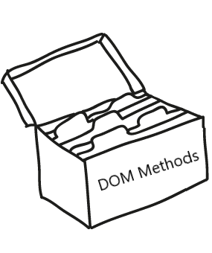
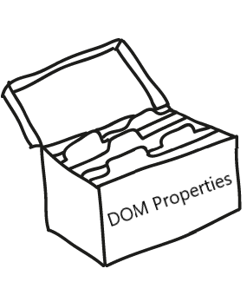
DOM Methods
DOM Methods - actions you can perform on HTML elements
DOM Properties - values of HTML elements that you can set or change

Slide 9
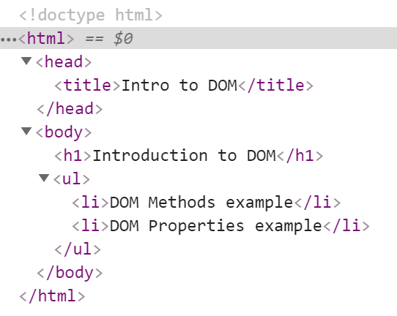



Example: DOM Methods
HTML DOM method is an action you can do (like add or delete an HTML element)

Slide 10
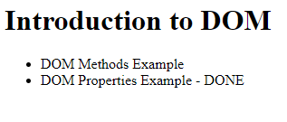
Example: DOM Methods
HTML DOM property is a value that you can get or set (changing the content of an HTML element)

Slide 11

DOM Manipulations
Modify the DOM Tree

Slide 12
Selection of Elements
There are a few ways to find a certain HTML element in the DOM:
By id - getElementById()
By tag name - getElementsByTagName()
By class name - getElementsByClassName()
By CSS selector - querySelector()

Slide 13
CSS Selectors
CSS selectors are strings that follow CSS syntax for matching
They allow very fast and powerful element matching, e.g.:
"#main" - returns the element with ID "main"
"#content div" - selects all <div>s inside #content
".note, .alert" - all elements with class "note" or "alert"
"input[name='login']" - <input> with name "login"

Slide 14

DOM Manipulations
The HTML DOM allows JavaScript to change the content of HTML elements
innerHTML
attributes
setAttribute()
style.property

Slide 15

DOM Manipulations
We can create, append and remove HTML elements dynamically
removeChild()
appendChild()
replaceChild()
document.write()

Slide 16
Creating DOM Elements
Creating a new DOM element
Create a copy / cloning DOM element
The above code creates a new elements. But these elements don't exist anywhere except as values inside variables.
Tag name
let p = document.createElement("p");
let li = document.createElement("li");
let li = document.getElementById("my-list");
let newLi = li.cloneNode(true);

Slide 17
Deleting DOM Elements
<div id="div1">
<p id="p1">This is a paragraph.</p>
<p id="p2">This is another paragraph.</p>
</div>
let parent = document.getElementById("div1");
let firstChild = document.getElementById("p1");
let secondChild = document.getElementById("p2");
firstChild.remove();
parent.removeChild(secondChild);
Directly deleting
Deleting by parent element

Slide 18
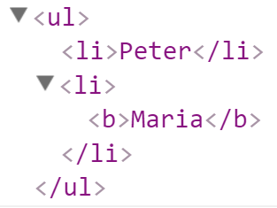
Creating DOM Elements
let list = document.createElement("ul");
let firstLi = document.createElement("li");
firstLi.textContent = "Peter";
list.appendChild(firstLi);
let secondLi = document.createElement("li");
secondLi.innerHTML = "<b>Maria</b>";
list.appendChild(secondLi);
document.body.appendChild(list);

Slide 19

DOM Properties and HTML Attributes

Slide 20
Properties vs. Attributes
Attributes are defined by HTML. Properties are defined by the DOM
Attributes initialize DOM properties
Property values can change
Attribute values can't
The HTML attribute and the DOM property are not the same thing, even when they have the same name

Slide 21
DOM Properties
textContent - reads and writes text
innerHTML - returns and writes the HTML of a given element
value - gets and sets value
let text = Node.textContent;
Node.textContent = 'New text for element.';
let html = myElement.innerHTML;
myElement.innerHTML = 'New text for element.';
let theValue = theFormField.value;
theFormField.value = 'New value';

Slide 22
HTML Attributes and Methods
getAttribute() - returns the value of attributes of specified HTML element
<input type="text" name="username"/>
<input type="password" name="password"/>
const inputEle = document.getElementByTagName('input')[0];
inputEle.getAttribute('type'); // text
inputEle.getAttribute('name'); // username

Slide 23
HTML Attributes and Methods
setAttribute() - sets the value of an attribute on the specified HTML element
<input type="text" name="username"/>
<input type="password" name="password"/>
<input type="text" name="username"/>
<input type="password" />
const inputPassEle = document.getElementsByTagName('input')[1];
inputPassEle.setAttribute('name', 'password');

Slide 24
HTML Attributes and Methods
removeAttribute() - removes the attribute with the specified name from an HTML element
<input type="text" name="username" placeholder="Username..."/>
<input type="password" name="password"/>
<input type="text" name="username" placeholder="Username..."/>
<input type="password" name="password" placeholder="Password..."/>
const inputPassEle = document.getElementsByTagName('input')[1];
inputPassEle.removeAttribute('placeholder');

Slide 25
HTML Attributes and Methods
hasAttribute() - method returns true if the specified attribute exists, otherwise it returns false
<input type="text" name="username" placeholder="Username..."/>
<input type="password" name="password" id="password"/>
const passwordElement = document.getElementById(password');
passwordElement.hasAttribute('name'); // true
passwordElement.hasAttribute('placeholder'); // false

Slide 26
HTML Attributes and Methods
classList - is a read-only property that returns a collection of the class attributes of specified element
<div class="container div root"></div>
const element = document.getElementById('myDiv').classList;
// DOMTokenList(3) ["container", "div", "root", value: "container div root"]

Slide 27
HTML Attributes and Methods
classList Methods
add() - Adds the specified class values
remove() - Removes the specified class values
<div class="container div root testClass"></div>
<div class="div root testClass"></div>
<div class="container div root"></div>
document.getElementById('myDiv').classList.add('testClass');
document.getElementById('myDiv').classList.remove('container');

Slide 28

Parents and Child Elements

Slide 29
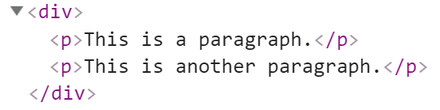

Parents and Child Elements
Every DOM Elements has a parent
Parents can be accessed by keywords .parent or .parentNode
Accessing the first child
let firstP = document.getElementsByTagName('p')[0];
console.log(firstP.parent);
Accessing the child parent

Slide 30
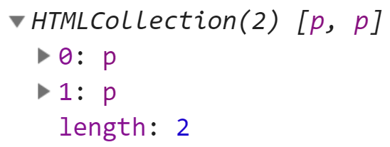
Parents and Child Elements
When some element contains other elements, that means he is parent of this elements
Also this elements is children to the parent. They can be accessed by keyword .children
Returns HTML Collection
let pElements = document.getElementsByTagName('div')[0].children;

Slide 31
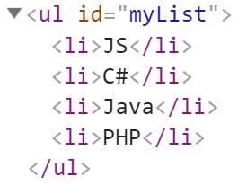
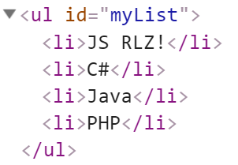

Parents and Child Elements
firstElementChild - Returns the first child node of an element
lastElementChild - Returns the last child node of an element
let list = document.getElementById('myList');
list.firstElementChild;
list.lastElementChild;
list.firstElementChild.textContent += " RLZ!";

Slide 32
Parents and Child Elements
nextElementSibling - Returns the next node at the same node tree level
previousElementSibling - Returns the previous node at the same node tree level
let ul = document.getElementById('myList');
let next = ul.children[0].nextElementSibling;
console.log(next.textContent); // C#
let prev = next.previousElementSibling;
console.log(prev.textContent); // JS

Slide 33
Parents and Child Elements
appendChild - Adds a new child, as the last child
prepend - Adds a new child, as the first child
let p = document.createElement("p");
let li = document.createElement("li");
li.appendChild(p);
let ul = document.getElementById("my-list");
let li = document.createElement("li");
ul.prepend(li);

Slide 34
NodeList vs. HTMLCollection
Both interfaces are collections of DOM nodes
NodeList can contain any node type
HTMLCollection is supposed to only contain Element nodes
An HTMLCollection provides the same methods as a NodeList and additionally a method called namedItem

Slide 35

DOM Events
Handling DOM Events

Slide 36
DOM Events
Events are actions or occurrences
They allow JavaScript to register different event handlers on elements
Events are normally used in combination with functions, and the function will not be executed before the event occurs
htmlRef.addEventListener( 'click' , handler );

Slide 37
BOM
Browser Object Model (BOM)
The Built-In Browser Objects

Slide 38
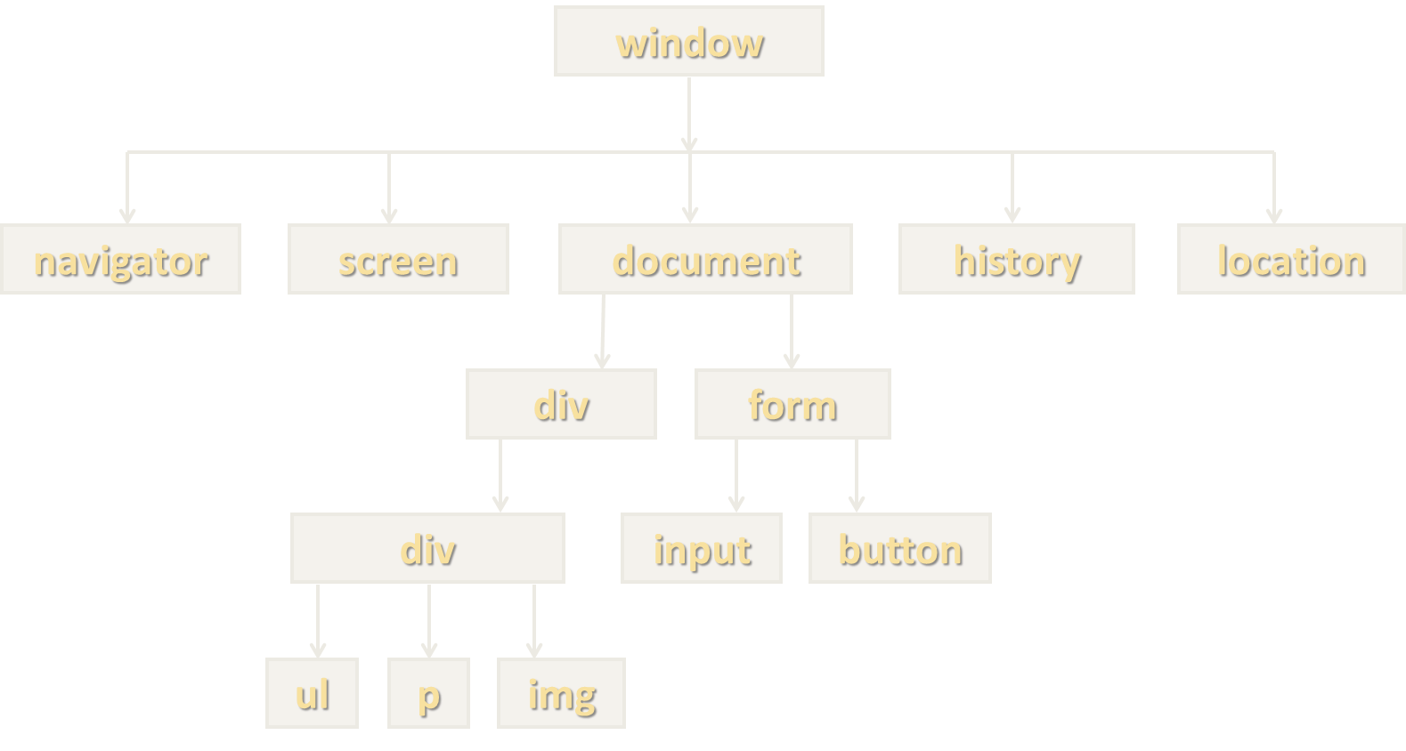
Browser Object Model (BOM)
Browsers expose some objects like window, screen, navigator, history, location, document, …
console.dir(window);
console.dir(navigator);
console.dir(screen);
console.dir(location);
console.dir(history);
console.dir(document);

Slide 39
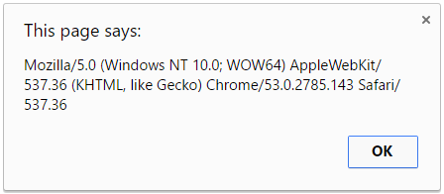
Playing with BOM
alert(window.navigator.userAgent);
console.log(navigator.language);
// en-US
console.log(screen.width + " x " + screen.height);
// 1920 x 1080
document.location = "https://softuni.bg";
history.back();

Slide 40

Summary
DOM
DOM is a programming API for HTML and XML documents
DOM Methods and Properties
DOM Manipulations
BOM
…
…
…

Slide 41
https://softuni.bg/courses/js-advanced

Slide 42












SoftUni Diamond Partners

Slide 43




SoftUni Organizational Partners

Slide 44




Trainings @ Software University (SoftUni)
Software University - High-Quality Education and Employment Opportunities
softuni.bg
Software University Foundation
http://softuni.foundation/
Software University @ Facebook
facebook.com/SoftwareUniversity
Software University Forums
forum.softuni.bg

Slide 45

License
This course (slides, examples, demos, videos, homework, etc.) is licensed under the "Creative Commons Attribution-NonCommercial-ShareAlike 4.0 International" license

